Slide 1



Day 27
contact@anubhavtrainings.com
ABAP RESTFUL APPLICATION PROGRAMMING

Slide 2

Agenda – Day 27
Local Types/Classes in ABAP with Global Classes
Implementing Class Pool Concept
Behavior Definition Introduction
Create Behavior Definition
Create Behavior implementation for Unmanaged Scenario

Slide 3
Local Types/Classes in ABAP with Global Classes
Local Types for Global Classes - Within class pools, as in virtually any other ABAP program, data types, local interfaces, and local classes can be defined to ensure a better structure of the implementation of the global class.
More number of classes will cause confusion and over-modularization increase the complexity of our design
More number of global classes, will increase the chance of our code being exposed to reports/classes which we may want to use only a private
Allow a modularized way of designing app but still keeping our code in a single contain, a good balance between number of classes v.s modularization.
At times we need so many classes for different purpose with very limited no of methods. 2 meh. + 20 classes, Create a class pool would be a good options.

Slide 4
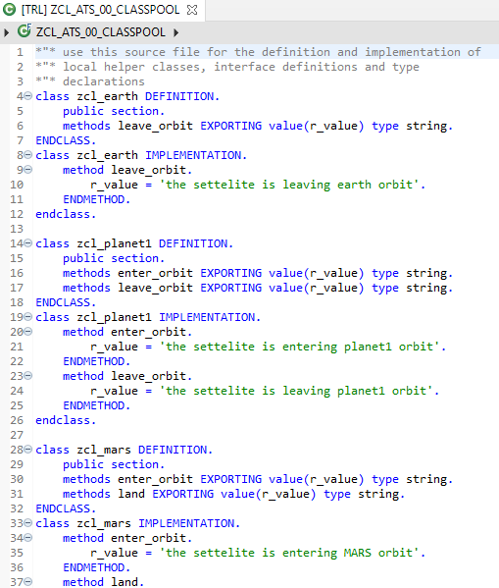
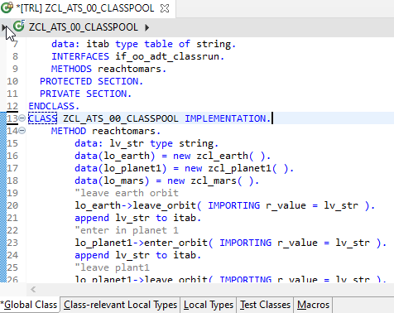
Implementing Class Pool Concept
Global Class
Exercise
Class Pool Code
Local Types/Class

Slide 5
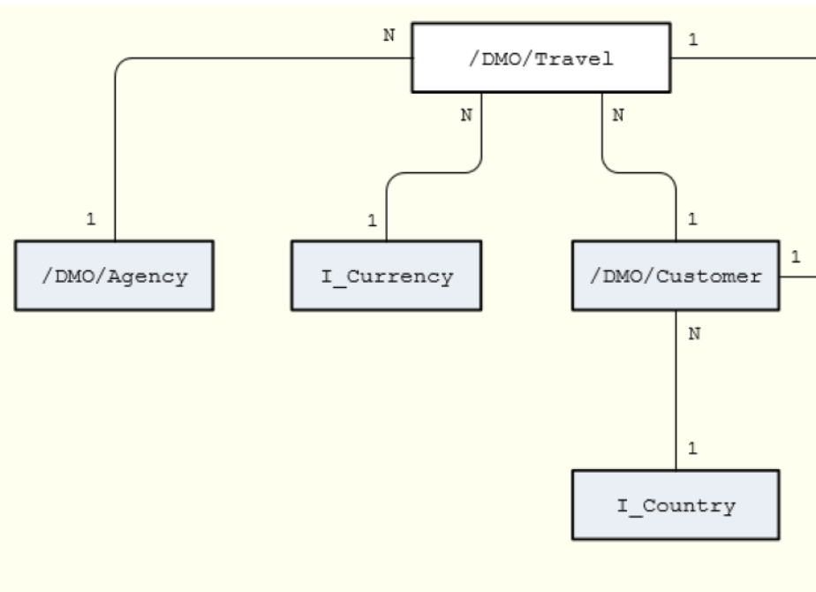
Un-managed Implementation
The scenario described below focuses on an unmanaged implementation type of a business object provider in the context of the ABAP RESTful programming model.
For the unmanaged implementation type, the application developer must implement essential components of the REST contract itself. In this case, all required operations (create, update, delete, or any application-specific actions) must be specified in the corresponding behavior definition before they are manually implemented in ABAP.
The figure below shows the relationships between the travel, agency and customer entities where the travel entity represents the root of the data model. Additional entities for currencies (I_Currency) and countries (I_Country) are generally available in your system and are included in our data model using associations.

Slide 6
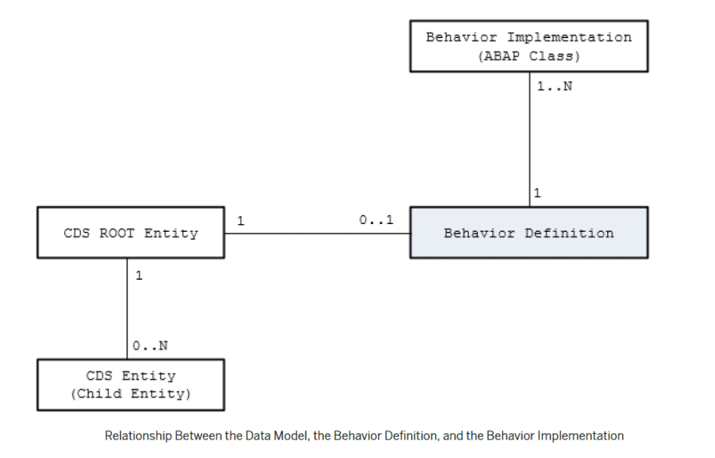
Behavior Definition
A business object behavior definition (behavior definition for short) is an ABAP Repository object that describes the behavior of a business object in the context of the ABAP RESTful programming model.
A behavior definition is defined using the Behavior Definition Language (BDL) and comprises capabilities and modelling aspects of the business object node or nodes, for example the supported operations (such as create, update, and delete actions) or the definition of lock dependencies between the parent and child nodes.
A behavior definition always refers to a CDS data model. This reference results from the name equality with the root entity. This means that a CDS data model must always exist before the behavior definition is created.
A behavior definition relies directly on the CDS root entity.
One behavior definition refers exactly to one root entity and one CDS root entity has a maximum of one behavior definition (a 0..1 relationship), which also handles all associated (child) entities.
The implementation of a behavior definition can be done in a single ABAP class (behavior pool) or can be split between an arbitrary set of ABAP classes (behavior pools). You can assign any number of behavior pools to a behavior definition (a 1: n relationship).

Slide 7
Behavior Pool
The transactional behavior of a business object in the context of the current programming model is implemented in a global ABAP class or classes. These special classes are dedicated only to implementing the business object’s behavior and are called behavior pools.
the implementation of a behavior definition can be done in one class or split across an arbitrary set of ABAP classes.
You can assign any number of behavior classes to a behavior definition (a 1: n relationship). Within a single global class, you can define multiple local classes that handle the business object’s behavior.
The global class is just a container and is basically empty while the actual behavior logic is implemented in local classes.
Local class 1 for Entities
Behavior Definition
Class Pool
Local class 2 for Entities
Local class 3 for Entities

Slide 8
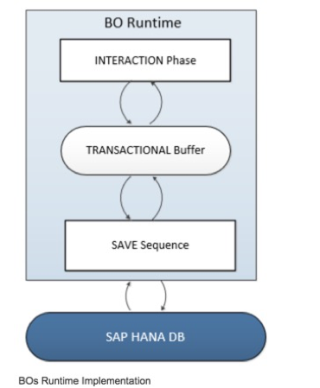
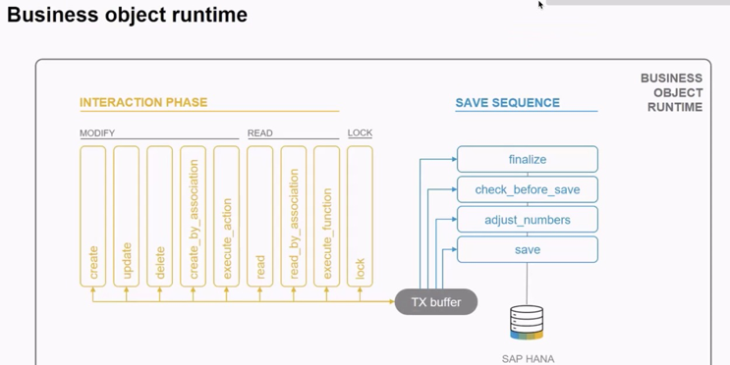
Business Object’s Runtime Implementation
The business object runtime mainly consists of two parts: The first part is the interaction phase where a consumer calls the business object operations to change data and read instances with or without the transactional changes. The business object runtime keeps the changes in its internal transactional buffer which represents the state of the instance data. This transactional buffer is always required for a business object. After all changes were performed, the data can be persisted. This is realized with the save sequence.

Slide 9
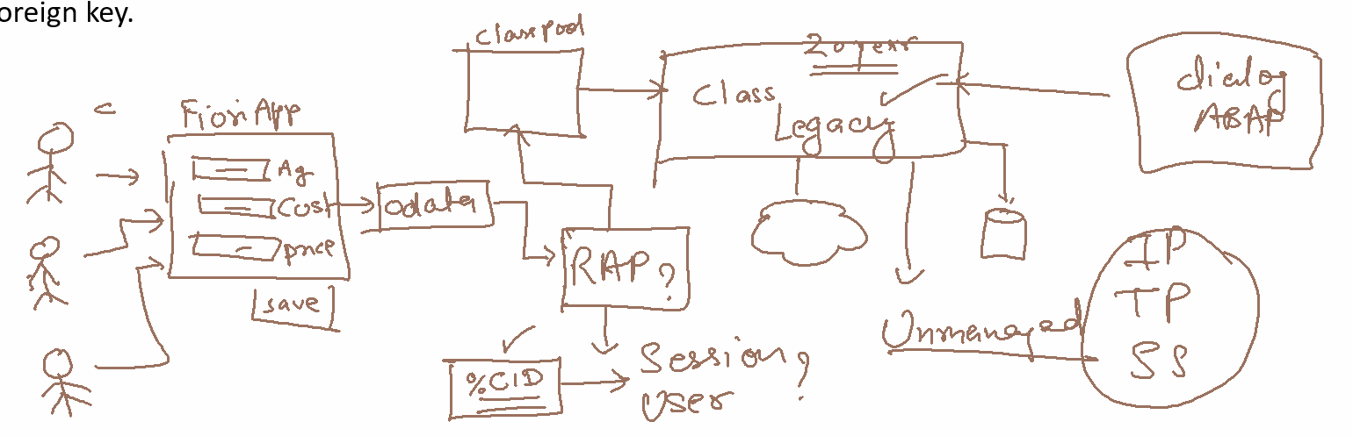
What is %CID
%CID stands for the content ID and is used in an OData request to bind the result of an operation to a name so that it can be referenced in another operation later in the transactional processing.
In some use cases, it may happen that a consumer works with data that is not yet persisted and might not have a primary key yet. The primary key can be created in the <method> FOR MODIFY call or later in the save sequence (late numbering). In such cases, a temporary primary key, the content ID (%CID) for an instance, is used as long as no primary key was created by BO runtime. The content ID is consequently also used then as a foreign key.

Slide 11
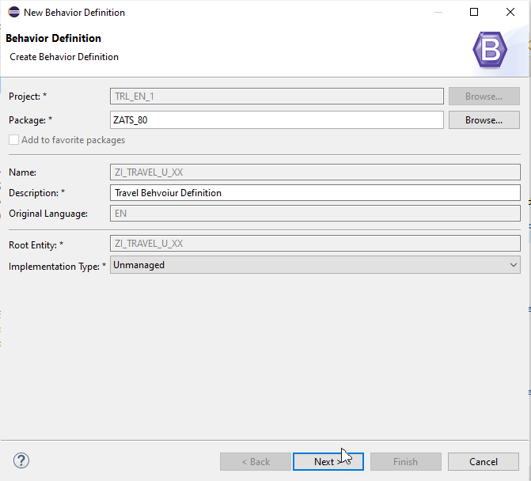
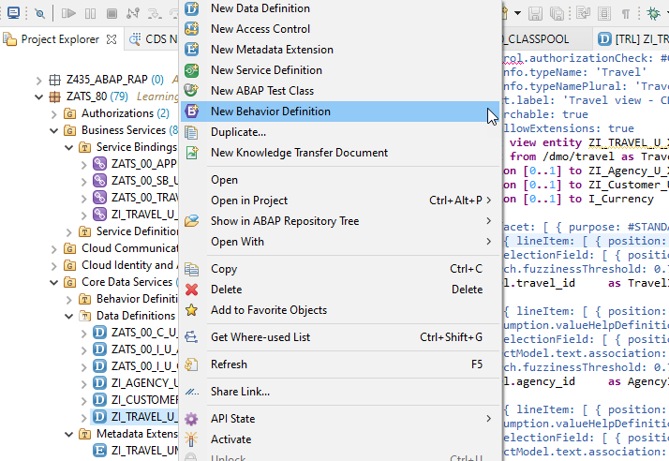
Create of Behavior Definition

Slide 12
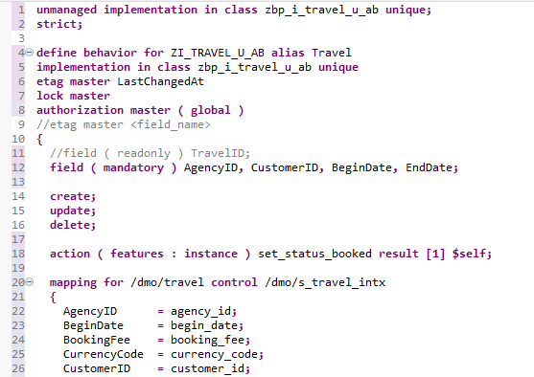
Implementing Behavior Definition
Exercise
Behavior Definition Code

Slide 13

End of Day 27
Trainer: Anubhav Oberoy

Slide 14
Trainer: Anubhav Oberoy

Slide 15
THANK YOU
If you cannot do
great things, do small things in a great way.
Anubhav Oberoy
https://www.anubhavtrainings.com

Slide 16


We’re committed to empower you to be
Most Desirable Resource
through powerful training solutions.
We build the workforce of the future.
250+
Corporate Clients
30,000+
Learners Trained
25000+
Learners Placed
FREE WEBINARS
Sign up for free webinars with industry experts every fortnight!
Enroll Now!
Contact us today!
https://anubhavtrainings.com/

Slide 17




More from AnubhavTrainings.com

